Slide 1

CIS 9650 - Spring 2021
Stroke (Brain Attack) Analysis and Predictive Modelling
Group 4:
Xin Bian, Bingxuan Hu, Atabay Kadiroglu,
Qiaoyi Tan, Wenyi Wang, Zixin Ye

Slide 2
Outline
Problem & Goal
Data Pre-Processing
Exploratory Data Analysis
Preparation for Model Building
Feature Selection
Comparison of Models
Writing our Program

Slide 3
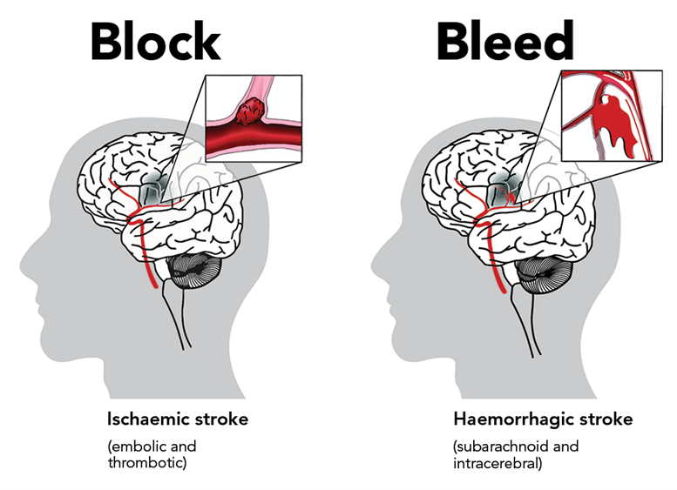
Problem and Goal
“Stroke(Brain attack) occurs when the blood supply to part of your brain is interrupted or reduced, preventing brain tissue from getting oxygen and nutrients. Brain cells begin to die in minutes.” (MayoClinic.org)
Our goal is to create a program that will allow patients to enter their information and get a predicted probability of having a stroke.

Slide 4
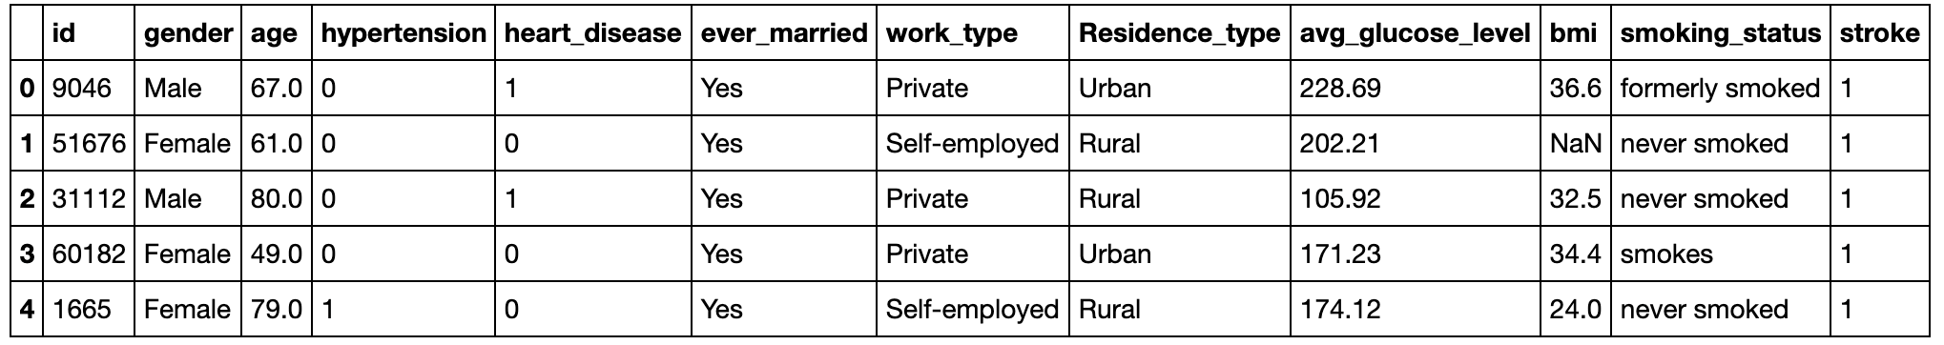
Stroke Data-Set
The dataset contains 5,110 observations with 12 attributes.
Unknown or N/A values imply that the information is either unavailable or not applicable.
Each observation provides the relevant health information of an anonymous individual.

Slide 5
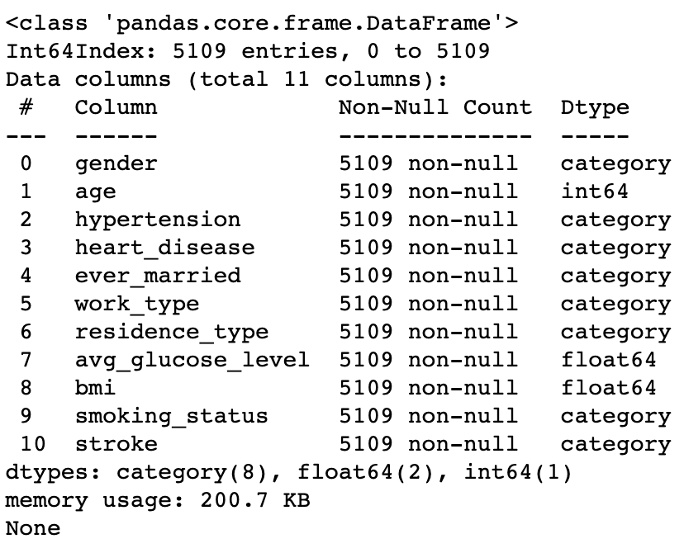
Pre-Processing
Removed Duplicate Rows
Imputed Null Values
Updated unique values by each feature
Changed data types

Slide 6
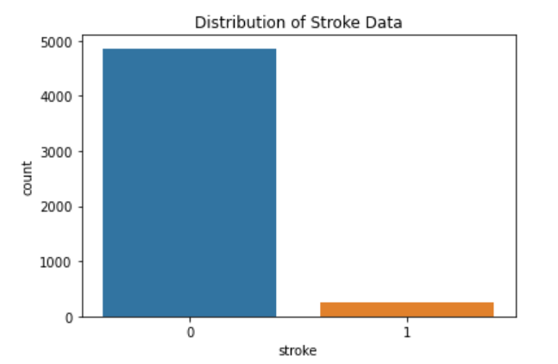

Exploratory Data Analysis (EDA)
Frequency of target variable
Imbalanced sample size

Slide 7
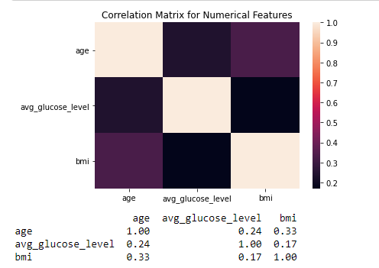
Exploratory Data Analysis (EDA)
The heat map
No numerical features are highly related

Slide 8
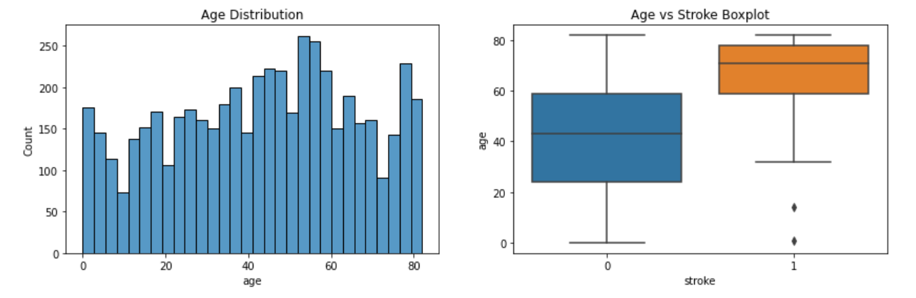
Exploratory Data Analysis (EDA)
Average Age Distribution
Notes:
Our mean age is around 40 and it seems that older people are more likely to have stroke. We can see that median age for people who had stroke is higher than people who didn't.

Slide 9
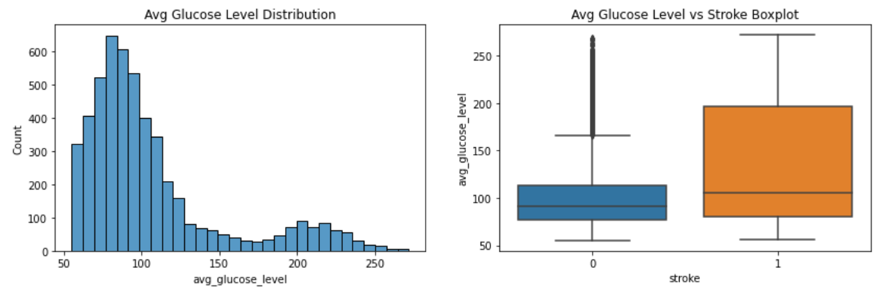
Exploratory Data Analysis (EDA)
Average Glucose Level Distribution
Notes:
Avg glucose level distribution is right_skewed with many outliers, and median value of avg glucose level is higher on people who had a stroke than those who didn't.

Slide 10
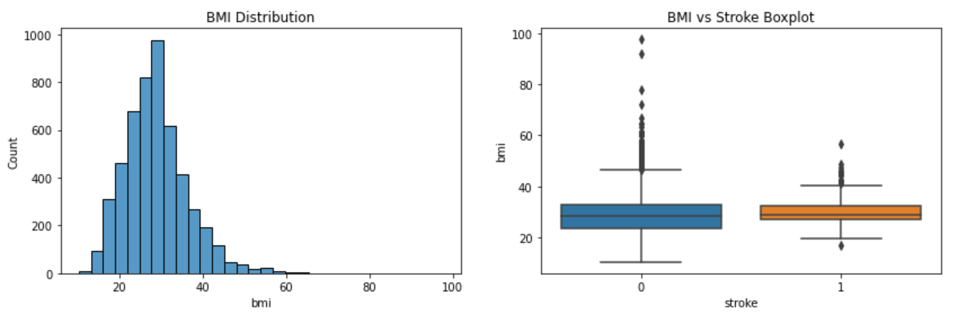
Exploratory Data Analysis (EDA)
BMI Distribution
Notes:
Bmi doesn't seem to have much correlation with stroke as the median values for both categories look almost the same. Also similar to avg glucose level, there are many outliers in bmi column. We will handle those outliers before we create our model.

Slide 11
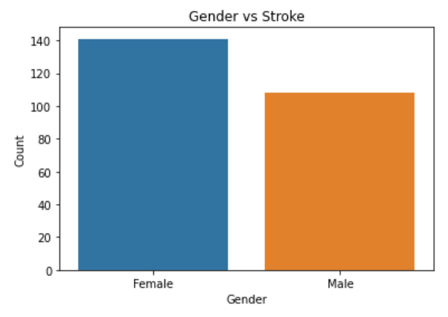
Exploratory Data Analysis (EDA)
Gender vs. Stroke
Female are more likely to get stroke.
Physiological differences
This condition can double a woman’s risk of having a stroke for years after the pregnancy.
Notes:
Base on these graphs, we can tell that female are more likely to get stroke

Slide 12
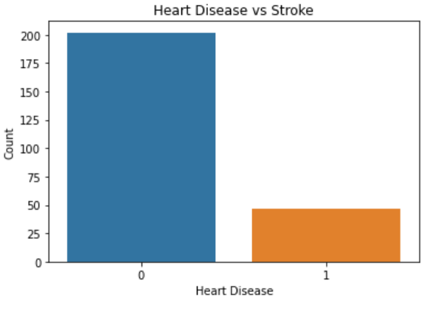
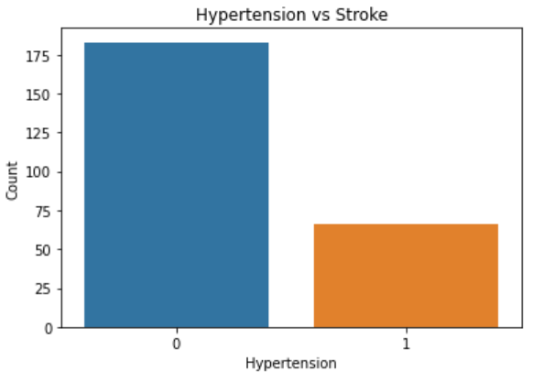
Exploratory Data Analysis (EDA)
Heart Disease vs. Stroke
Hypertension vs. Stroke
Heart disease and hypertension does not highly related with stroke.
Notes:
Large number of people who had a stroke don't have hypertension and any heart disease.

Slide 13
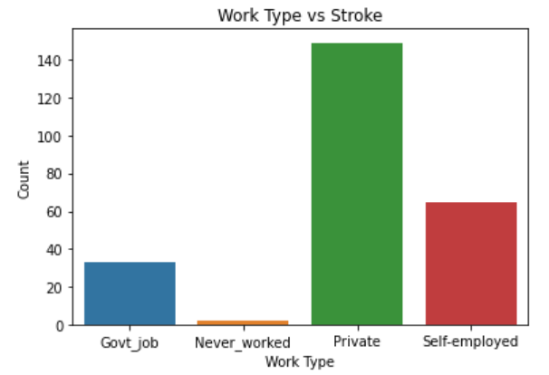
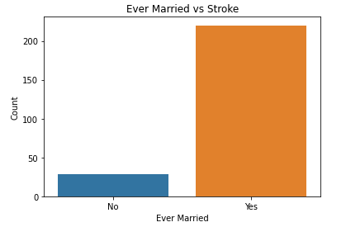
Exploratory Data Analysis (EDA)
Work Type vs. Stroke
Ever Married vs. Stroke
People work in private sector are more likely to get a stroke and smoking status does not seems have much relation to the stroke.
Notes:
Because private company employees may get more stress.

Slide 14
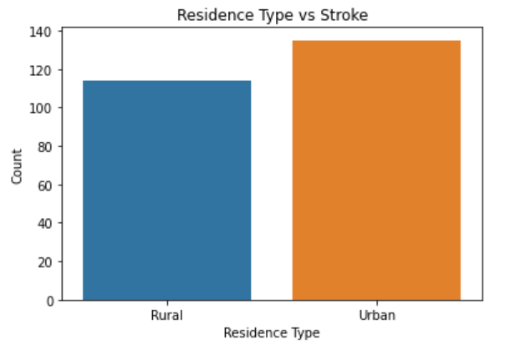
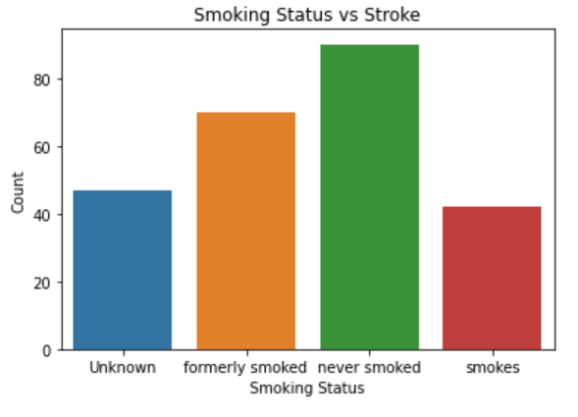
Exploratory Data Analysis (EDA)
Residence Type vs. Stroke
Smoking Status vs. Stroke

Slide 15
Data Preparation for Model Building
Remove Outliers
One Hot Encoding & Train-Test Splits
Synthetic Minority Oversampling Technique (SMOTE)

Slide 16
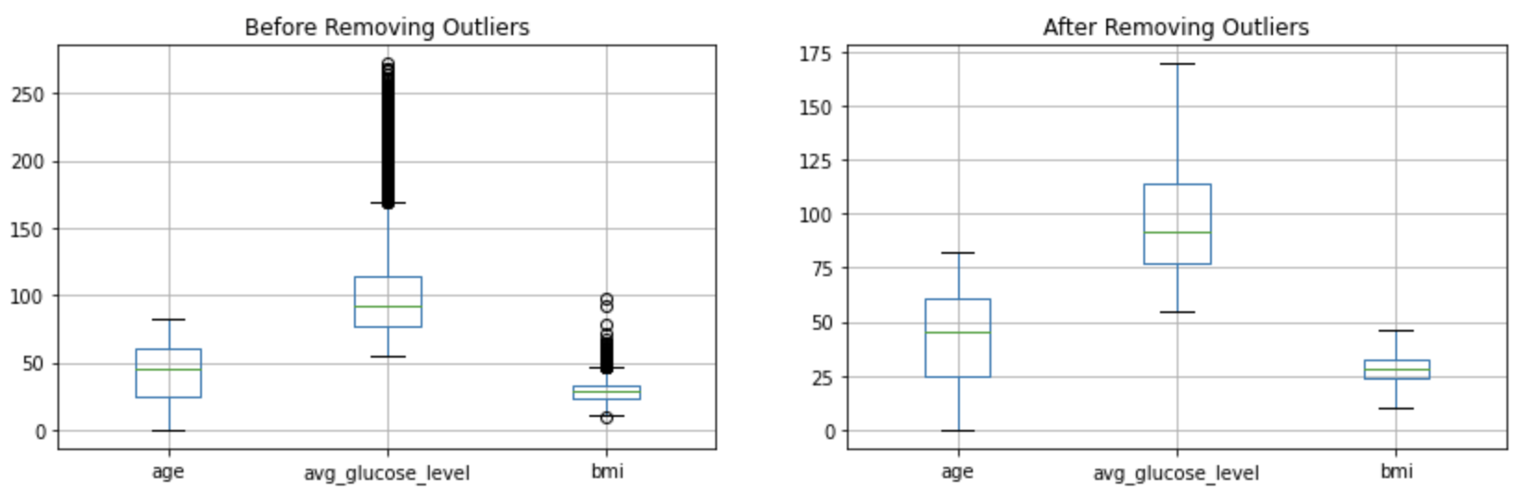
Removing Outliers
age : 0
avg_glucose_level : 627
bmi : 126
Total outlier count: 753

Slide 17
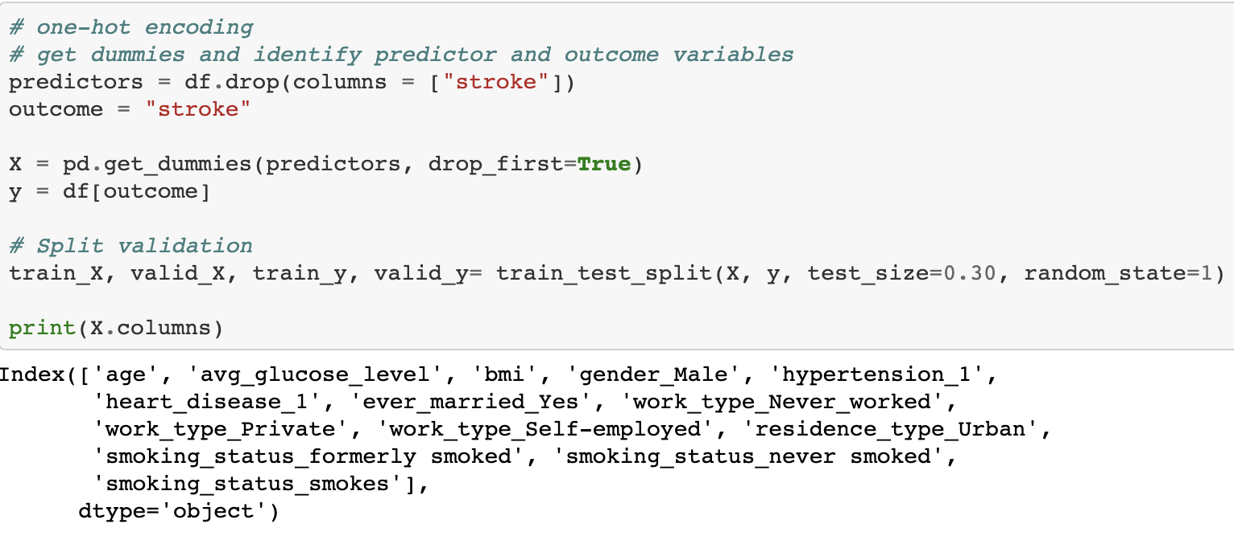
One-Hot Encoding

Slide 18
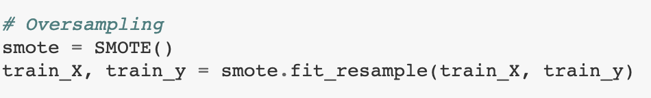
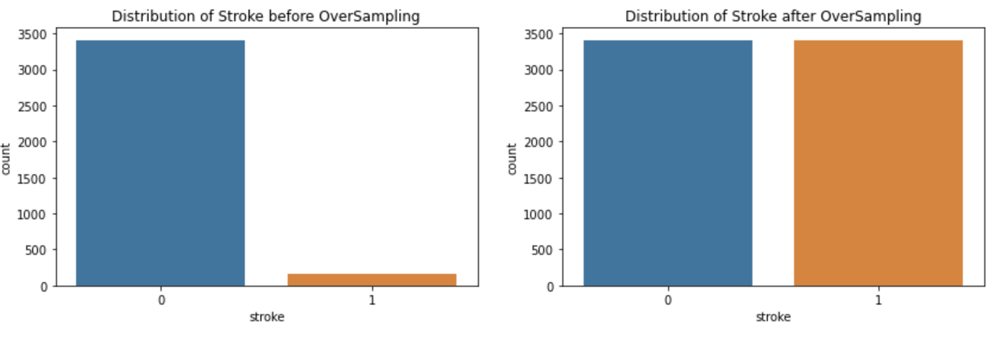
OverSampling (SMOTE)

Slide 19
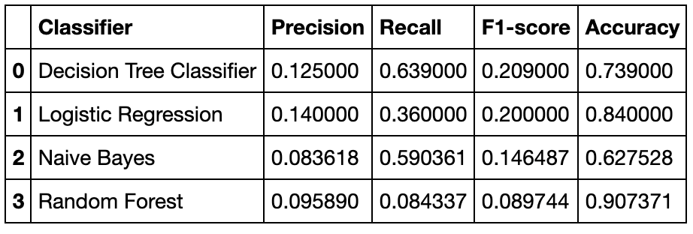
Comparison of Baseline Models
Use different classification models to calculate precision scores, recall scores, F-measure and accuracy after the oversampling data.

Slide 20
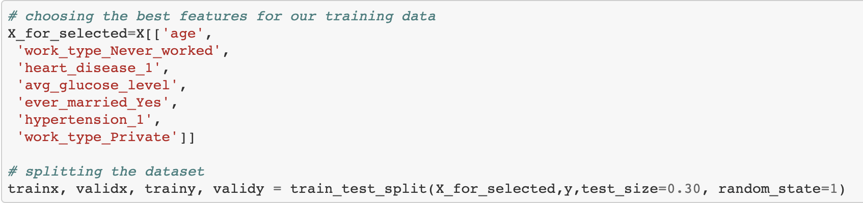
Feature Selection
A process of selecting the most significant and relevant features from a dataset.
This process is needed to eliminate less important and irrelevant features which lead to inaccurate predictions for our model.
Applying Forward Selection

Slide 21
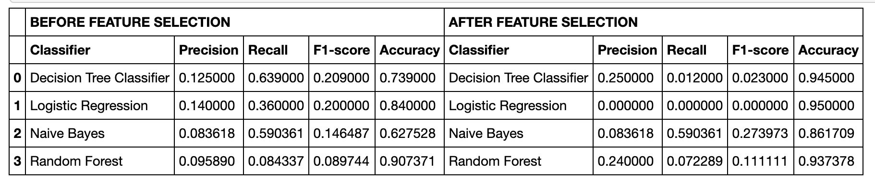
Comparison of Models After Feature Selection
The model with highest Accuracy, Recall and F1-score is Naive Bayes after feature selection
%32 increase in Accuracy Score and %80 increase in F1-score

Slide 22
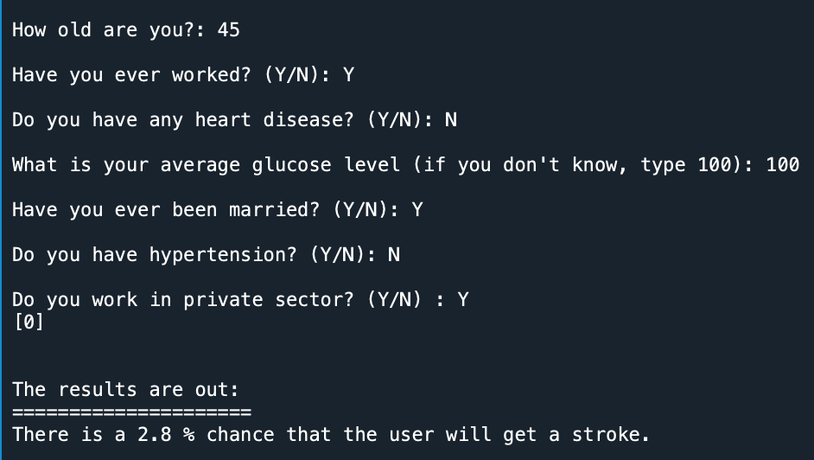
Writing our Stroke Prediction Program
Training our model with best selected features based on Naive Bayes Model:
age
work_type_never_worked
heart_disease_1
avg_glucose_level
ever_married_yes
hypertension_1
work_type_1

Slide 23
Interface
The user interface allows user to input their personal data and the program would analyze the inputs to determine how likely for that person to get a stroke.
It helps people to be alerted, and take preemptive measures to lower the risk of having a stroke

Slide 24


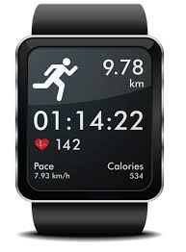



Practical Application
Apply our prediction model to wearable device and link to all medical history
Remote Health Management
Online-to-Offline Exercise Guidance
Stroke Risk
40%
History Record
Health Guide
How to Improve Gluclose Level?
Ask Doctor
Get Private Trainer
BrainShield

Slide 25
Conclusion
Cause a greater range of disabilities than any other condition.
A medical emergency that can be treated by getting the right treatment as soon as possible.
Our program is aim to help users to get warned and act ahead to prevent a stroke
The output of our analysis determines all the factors that affect the stroke incidence rate. The UI helps users to be alerted by any early symptoms and prevent them from getting a stroke.

Slide 26
Thanks for Watching!
Group 4:
Xin Bian, Bingxuan Hu, Atabay Kadiroglu,
Qiaoyi Tan, Wenyi Wang, Zixin Ye

